Slide 1
Concepts of Biology Biol 111 Minot State University
Lecture, MWF 12:00-12:50 pm
Cyril Moore Science Center, Room 16
Lab, Tuesdays/Thursdays
Swain Hall, Room 304

Slide 2
Lecture 29 April 18, 2018
Announcements—
Exam 4 not marked yet. Will get them back in lab next week. We will go over them Friday or Monday
Sorry for late posting of this week’s lab! I took off my teacher hat for a few days--☺

Slide 3
Where were we?...
Finding the chemical behind inheritance---what is the genetic material? What were they hunting for?
Is it protein? Is it DNA or RNA (nucleic acids)? Why was it narrowed to these 2 chemicals?
Who first showed that it was DNA and not protein (or RNA)?
What is a gene?

Slide 4
One key experiment…
This one is not mentioned in your text, but is pretty straight forward.
3 scientists…named Avery, McCleod, and McCarty did some experiments that showed that something that resembled a genetic molecule could be transferred between bacteria. They called this transfer and the change in the bacteria TRANSFORMATION

Slide 5
Since the argument was primarily between 2 types of chemicals (nucleic acids and proteins) these scientists just eliminated one or the other.
They were even able to eliminate the 2 types of nucleic acids—DNA and RNA---one at a time.

Slide 6
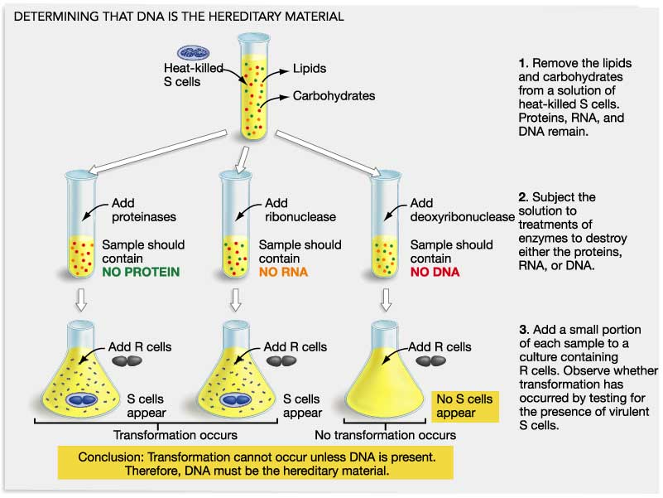
Avery McCloed, and McCarty’s experiment
NO Transformation
Transformation
Transformation

Slide 7
Only when DNA was eliminated was transformation stopped. So by process of elimination, the conclusion was that DNA was the genetic material.
Several other approaches came to the same conclusion. Your text mentions experiements of Hershey and Chase…read about it.

Slide 8
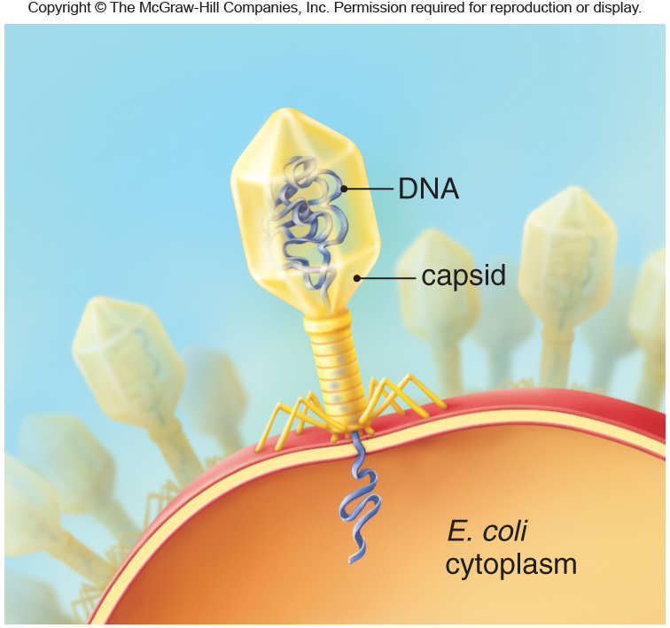
Your book describes experiments which tried to show the genetic material this virus was DNA.
(Protein)

Slide 9
Long story short…
Hershey and Chase discovered that an element only found in DNA was transferred from “mother virus” to “offspring viruses”
DNA contains phosphorus, but not sulfur.
Protein contains sulfur, but not phosphorus.
Which element/atom was found be important in the recipe” for new viruses?

Slide 10
DNA is here to stay!
With one exception, DNA IS the genetic material in all living things.
A few types of viruses utilize RNA as their genetic material. The Human Immunodeficiency Virus (HIV) is an example.
DNA and RNA are similar in their chemical make up.

Slide 11
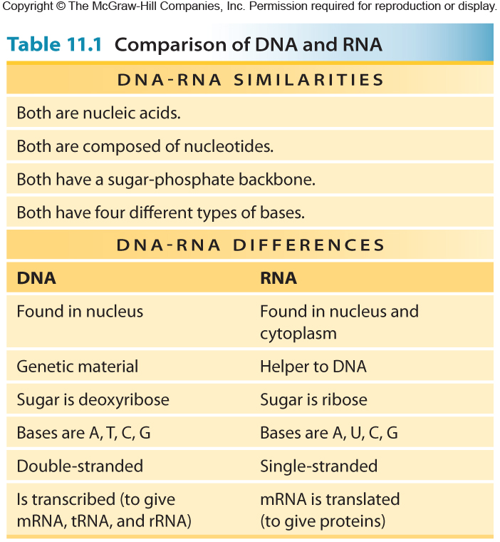
Table 11.1

Slide 12
Interesting fact!
It has long been thought that when life began, early life forms likely used RNA as their genetic material, but now only these few types of viruses maintain RNA as their genetic material.
DNA is less fragile than RNA---perhaps the transition to DNA stems in part from that.

Slide 13
Now…reported Fall 2017..

Slide 14
A new scientific focus
If DNA is the the genetic material----how does it work? What does it look like? Is it durable? How is it copied? How does it code for information? How might it change gradually?
Scientists took a couple of different paths.
Biochemistry
Structure studies—using a technique called X-ray diffraction

Slide 15
Biochemistry
A scientist named Erwin Chargaff knew a bit about the biochemistry of DNA. He knew that it is made of 4 different nucleotides, which differ only in the nitrogen-contain in base.
Recall the nucleotide bases: Adenine (A), guanine (G), Cytosine (C), Thymine (T)

Slide 16
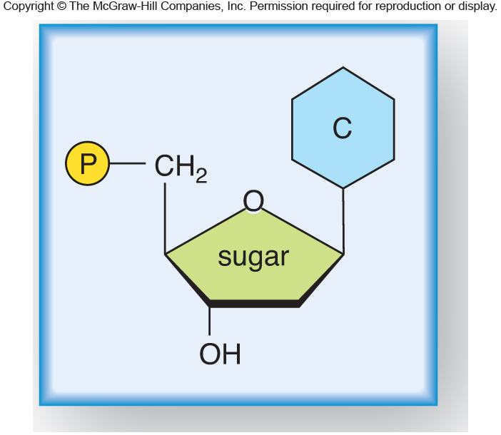
Fig. 11.2a

Slide 17
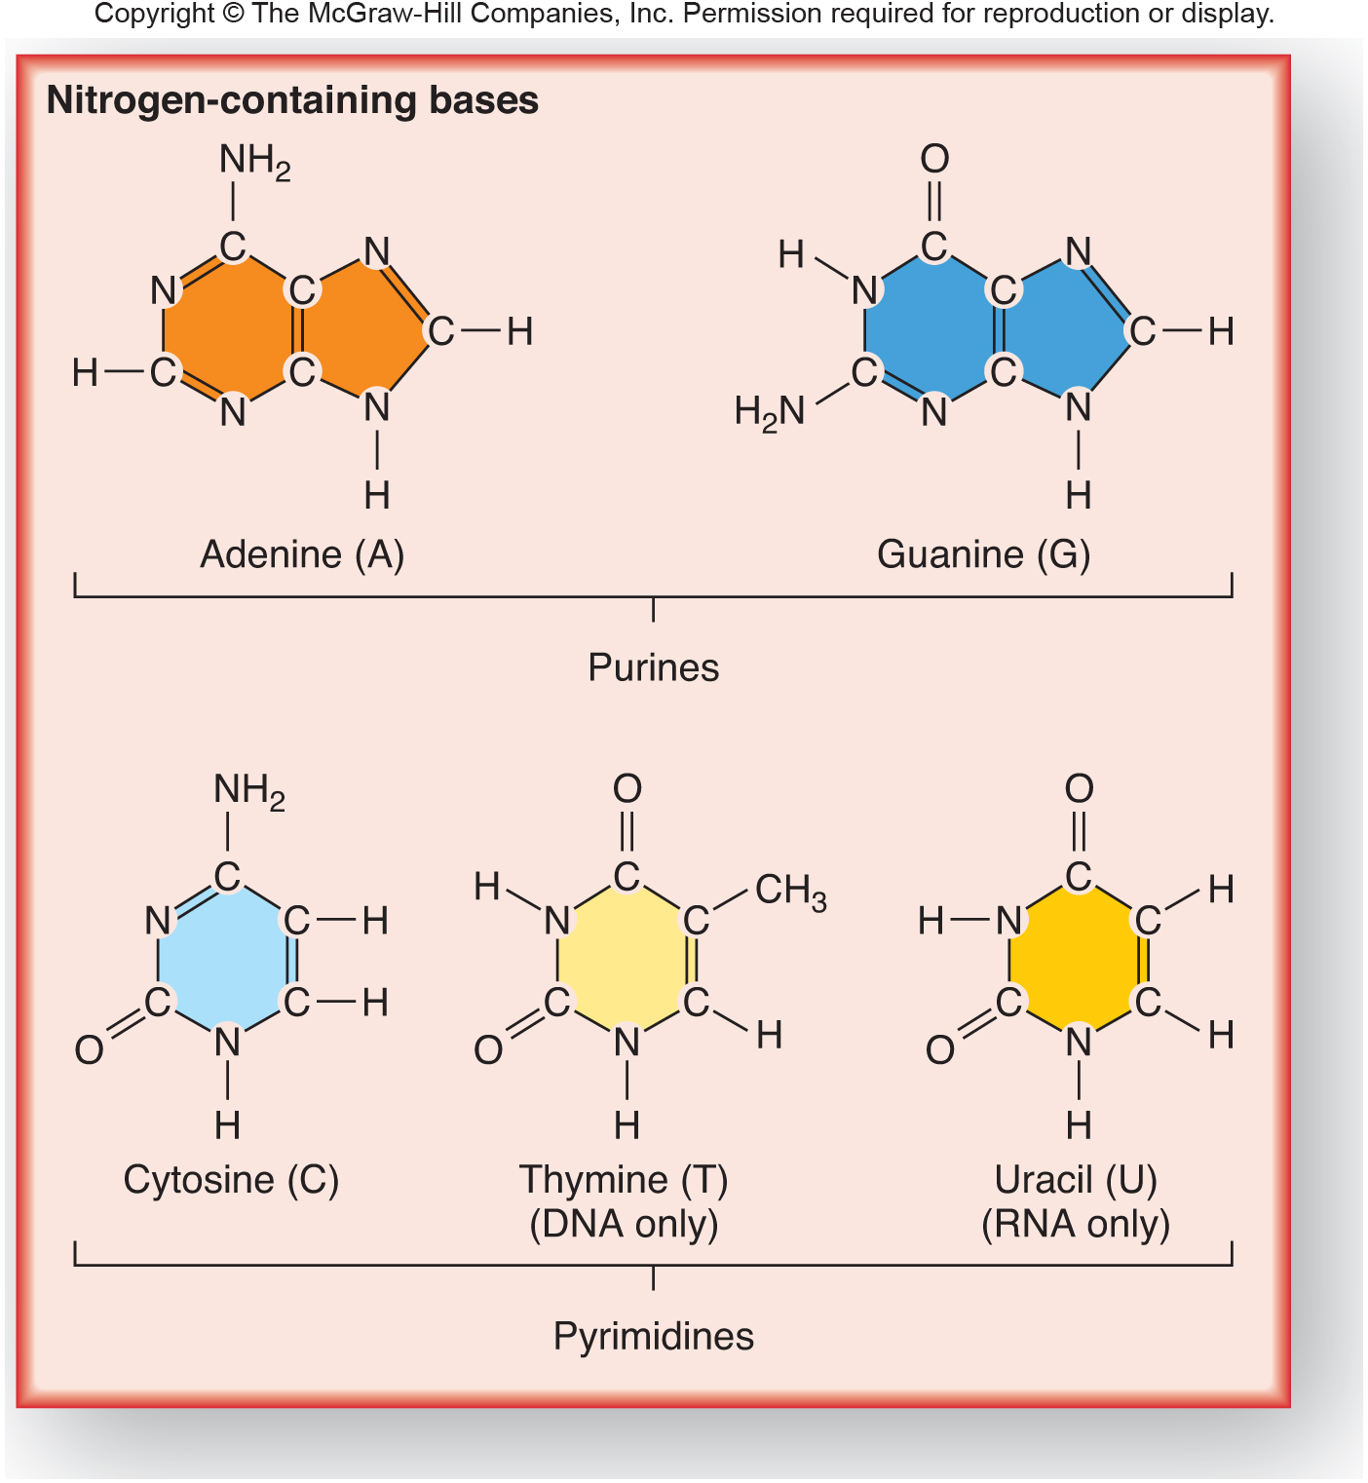
Fig. 11.2b

Slide 18
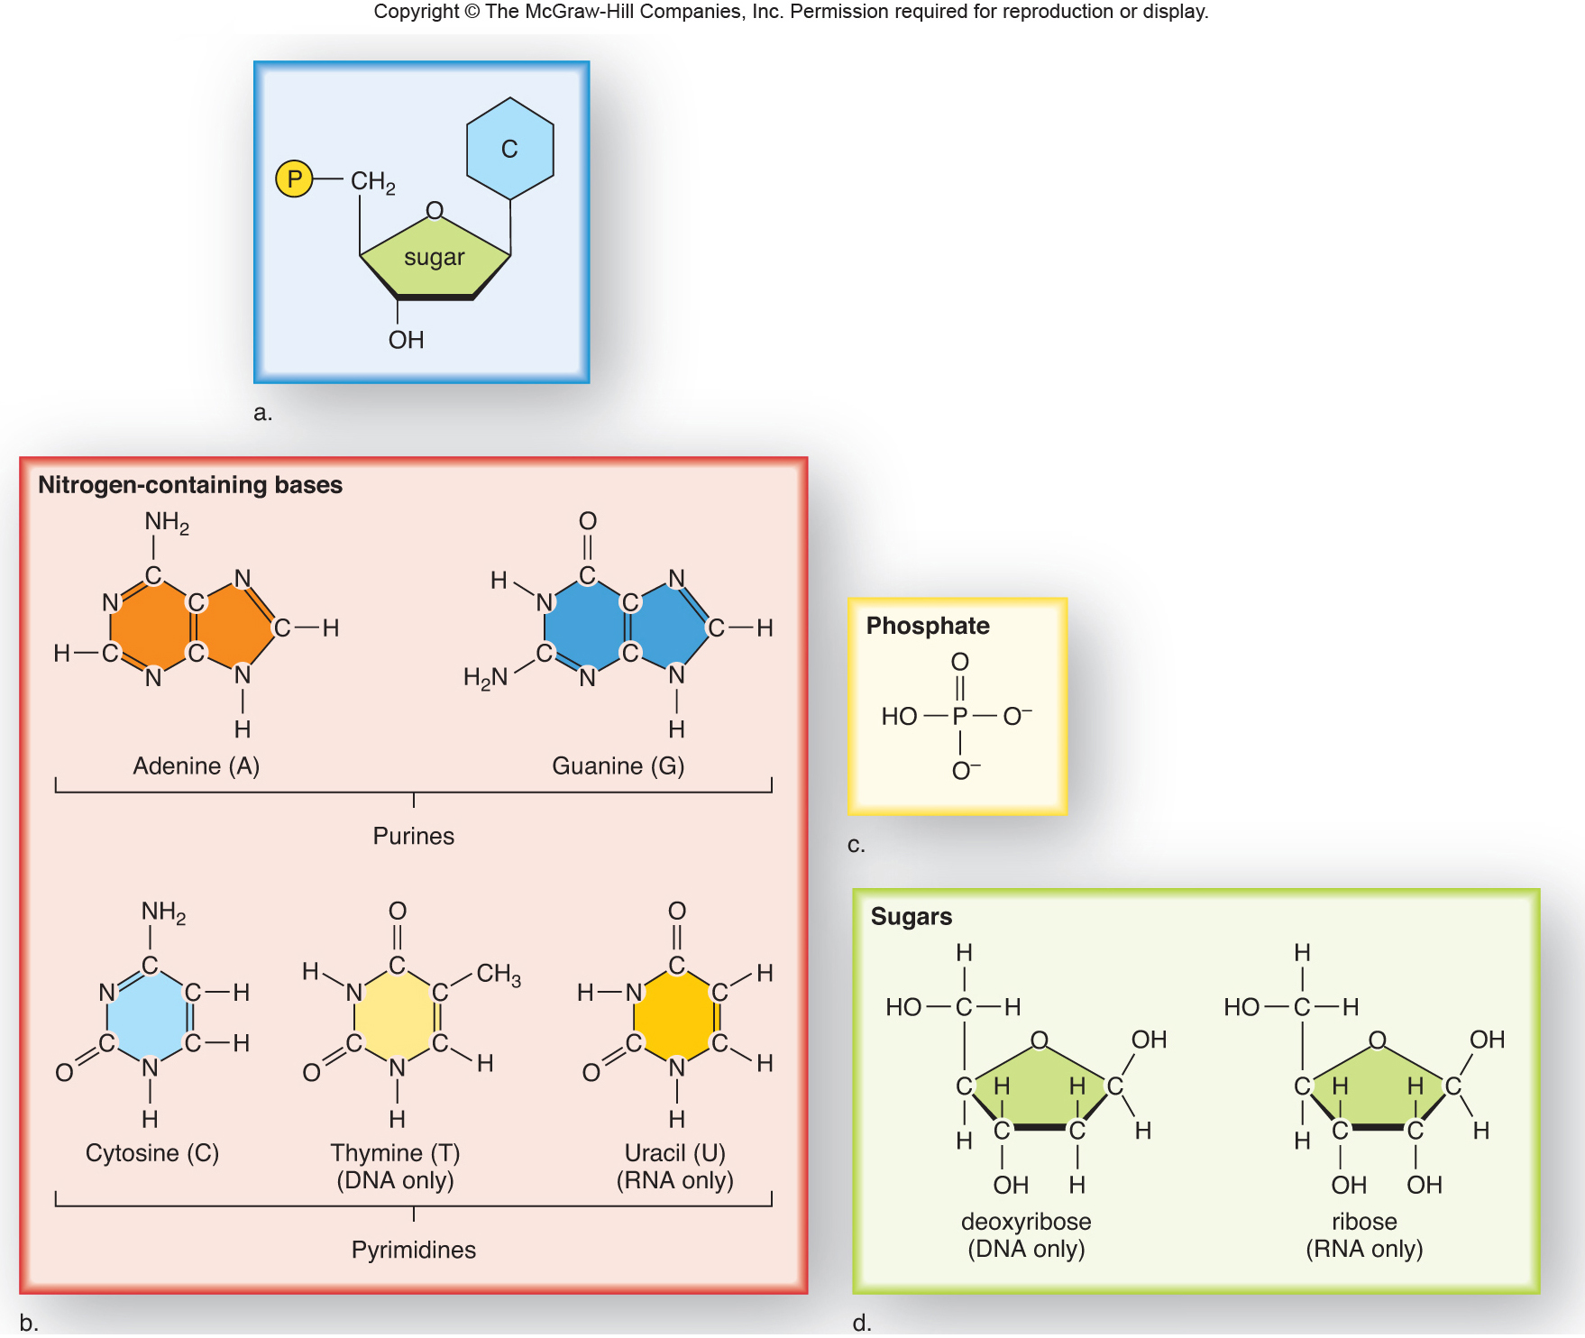
Fig. 11.2

Slide 19
Chargaff broke the DNA from several different organisms into pieces and measured the amounts of each base, A,G,C, and T.
He made 2 important conclusions.

Slide 20
1. The DNA of different organisms has different overall amounts of each type of base. For example, comparing bacteria with humans, each showed different amounts of C, T, A, and G.

Slide 21
Some base composition data for different organisms. Compare %A to %T and %C to%G for every organism.
Organism | %A | %G | %C | %T | A/T | G/C | %GC | %AT
φX174 | 24 | 23.3 | 21.5 | 31.2 | 0.77 | 1.08 | 44.8 | 55.2
Maize | 26.8 | 22.8 | 23.2 | 27.2 | 0.99 | 0.98 | 46.1 | 54
Octopus | 33.2 | 17.6 | 17.6 | 31.6 | 1.05 | 1 | 35.2 | 64.8
Chicken | 28 | 22 | 21.6 | 28.4 | 0.99 | 1.02 | 43.7 | 56.4
Rat | 28.6 | 21.4 | 20.5 | 28.4 | 1.01 | 1 | 42.9 | 57
Human | 29.3 | 20.7 | 20 | 30 | 0.98 | 1.04 | 40.7 | 59.3
Grasshopper | 29.3 | 20.5 | 20.7 | 29.3 | 1 | 0.99 | 41.2 | 58.6
Sea Urchin | 32.8 | 17.7 | 17.3 | 32.1 | 1.02 | 1.02 | 35 | 64.9
Wheat | 27.3 | 22.7 | 22.8 | 27.1 | 1.01 | 1 | 45.5 | 54.4
Yeast | 31.3 | 18.7 | 17.1 | 32.9 | 0.95 | 1.09 | 35.8 | 64.4
E. coli | 24.7 | 26 | 25.7 | 23.6 | 1.05 | 1.01 | 51.7 | 48.3

Slide 22
2. Despite the difference in amounts of each base, every organism showed the the same pattern:
Amount of A approximately equals amount of T
and amount of C approximately equals amount of G (A/T =1 and C/G=1)
This suggested a specific interaction between A and T and between G and C

Slide 23
Some base composition data for different organisms. Compare %A to %T and %C to%G for every organism.
Organism | %A | %G | %C | %T | A/T | G/C | %GC | %AT
φX174 | 24 | 23.3 | 21.5 | 31.2 | 0.77 | 1.08 | 44.8 | 55.2
Maize | 26.8 | 22.8 | 23.2 | 27.2 | 0.99 | 0.98 | 46.1 | 54
Octopus | 33.2 | 17.6 | 17.6 | 31.6 | 1.05 | 1 | 35.2 | 64.8
Chicken | 28 | 22 | 21.6 | 28.4 | 0.99 | 1.02 | 43.7 | 56.4
Rat | 28.6 | 21.4 | 20.5 | 28.4 | 1.01 | 1 | 42.9 | 57
Human | 29.3 | 20.7 | 20 | 30 | 0.98 | 1.04 | 40.7 | 59.3
Grasshopper | 29.3 | 20.5 | 20.7 | 29.3 | 1 | 0.99 | 41.2 | 58.6
Sea Urchin | 32.8 | 17.7 | 17.3 | 32.1 | 1.02 | 1.02 | 35 | 64.9
Wheat | 27.3 | 22.7 | 22.8 | 27.1 | 1.01 | 1 | 45.5 | 54.4
Yeast | 31.3 | 18.7 | 17.1 | 32.9 | 0.95 | 1.09 | 35.8 | 64.4
E. coli | 24.7 | 26 | 25.7 | 23.6 | 1.05 | 1.01 | 51.7 | 48.3

Slide 24
More work by the X-ray scientists showed the interaction was a pairing of specific bases (A with T and G with C) at the center of a helix.
Several scientists combined efforts lead to the publication of the structure of DNA. Only James Watson and Francis Crick were listed as authors on this paper published in 1953.

Slide 25
Rosalind Franklin, working in the lab of Maurice Wilkins did some elegant work and came up with what is considered the definitive X-ray picture of DNA…called photo 51.
It is thought that Watson and Crick may have used the photo to come to their conclusions. They did not give Dr. Franklin much credit.

Slide 26
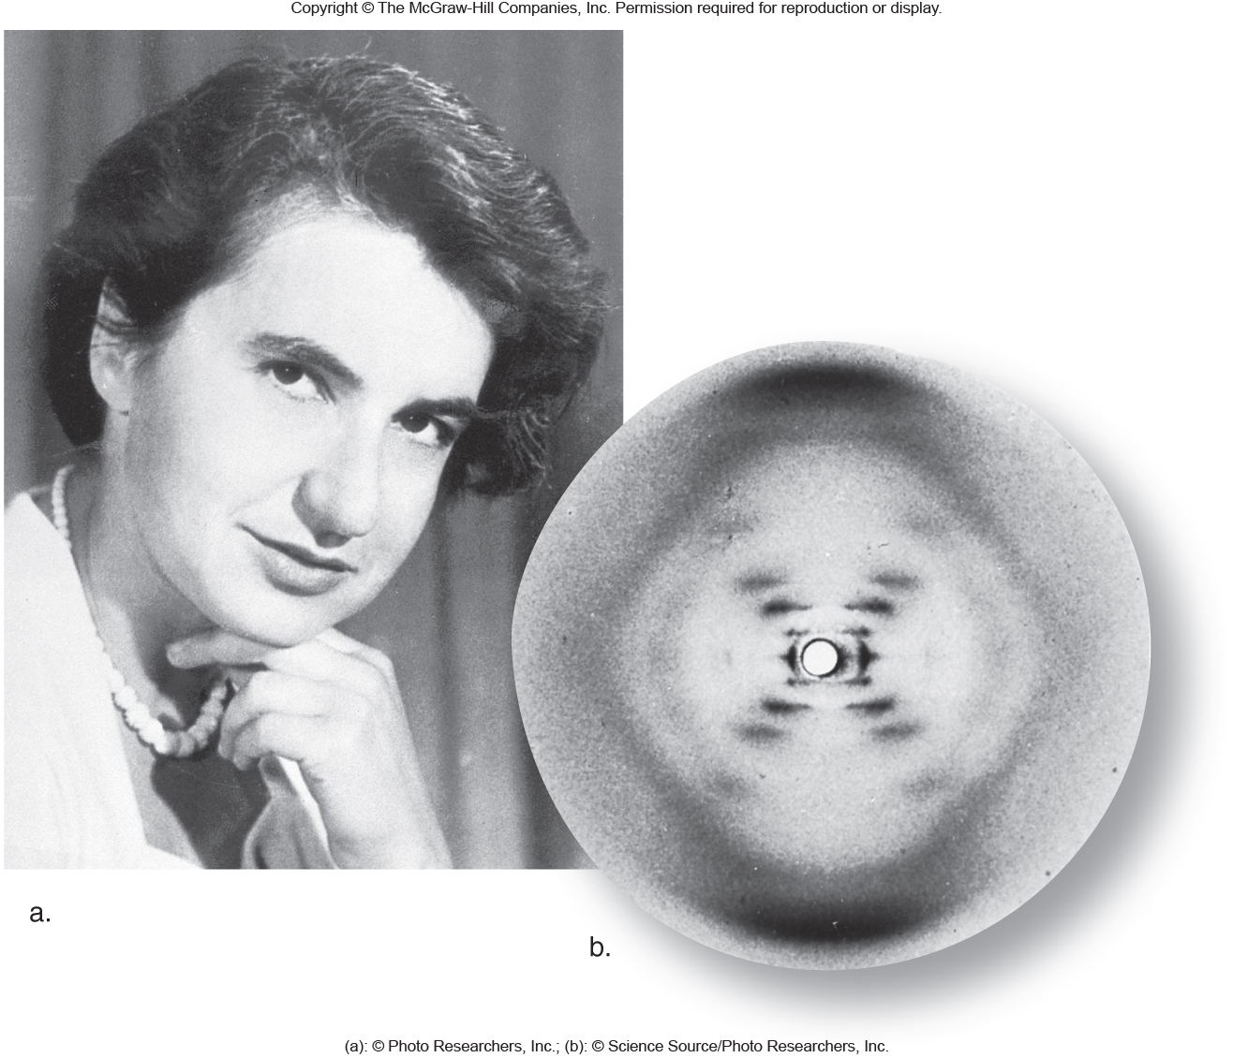
Fig. 11.3
Rosalind Franklin

Slide 27
Watson, Crick and Wilkins were awarded the Nobel Prize in 1962 for their description of DNA.
Unfortunately, Franklin had died by that time. She died of cancer that was likely induced by accidental exposure to X-rays.

Slide 28
The Nobel prize committee has a rule—no one is awarded the prize posthumously (after they are dead).
Something very unusual happened in 2011! A scientist was named as the Nobel winner on a Monday. He had died on the previous Friday.

Slide 29
Because the committee did not know he had died, the award will remain in place. 2011 will be remembered for this near-exception to the rule.

Slide 30
Where were we…
Together with biochemisrty information and structure details, W and C put forth their model for DNA.

Slide 31
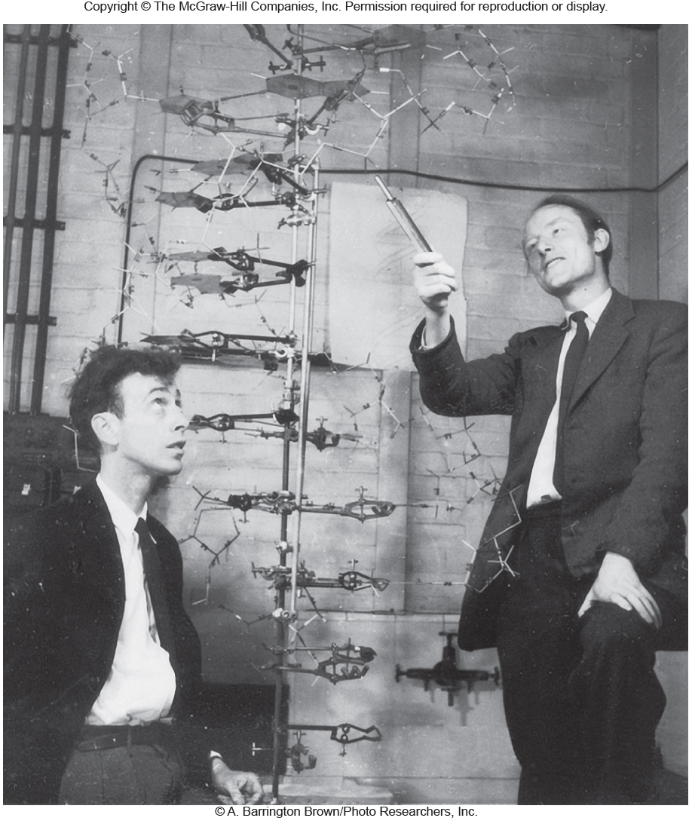
Fig. 11.4

Slide 32
The key points
DNA is made of 2 strands of deoxyribonucleotides
The strands are held together using base interactions (A with T and G with C)
These interactions are known as complementary base pairs.

Slide 33
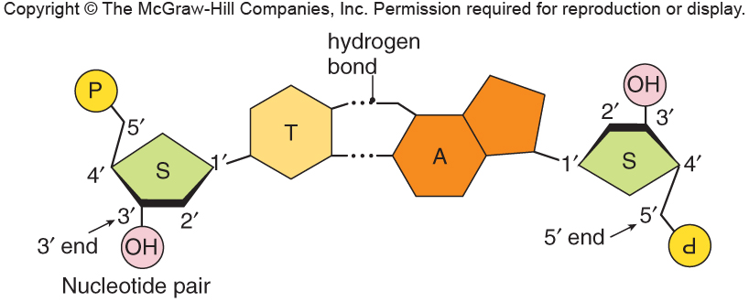
Fig. 11.5a
A and T form 2 Hydrogen bonds. Recall this non-covalent bond type

Slide 34
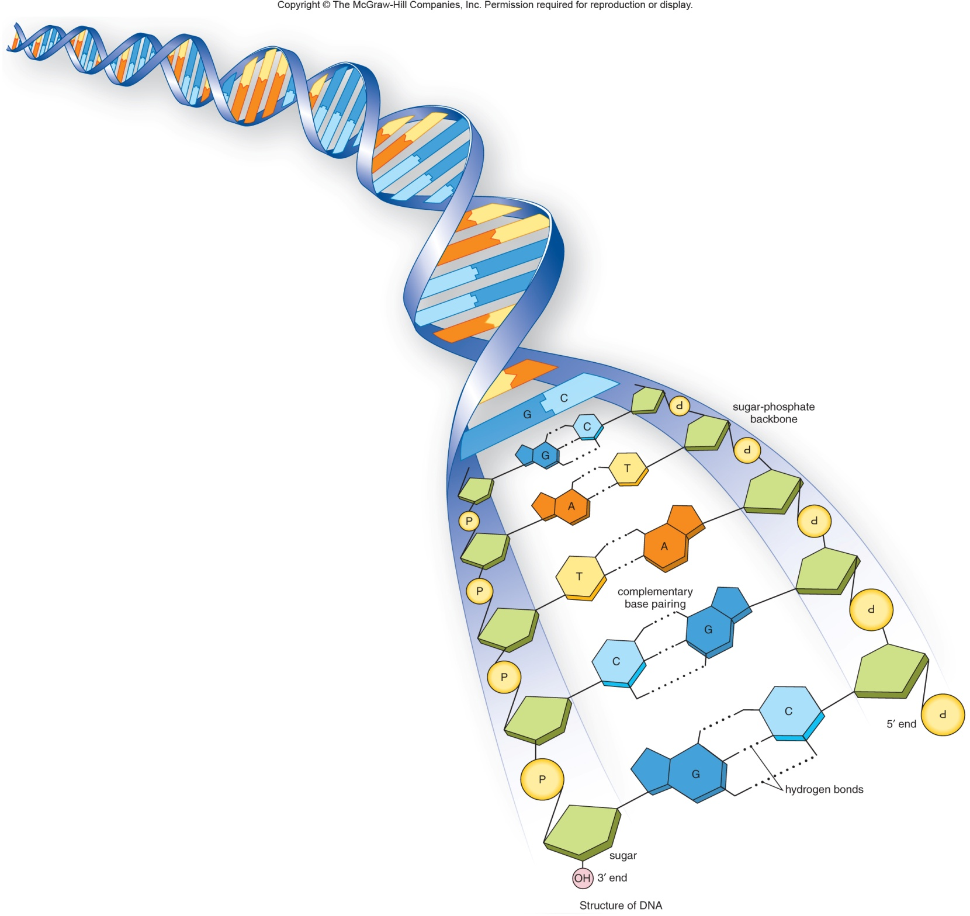
Fig. 11.5b
G and C form 3 Hydrogen bonds. G-C base pairs are stronger than A-T base pairs.

Slide 35
This complementarity----gave W and C a good idea of how the molecule might copy itself.
Other scientists supported the idea with experiments. One key set of experiments were done by 2 scientists---Messelson and Stahl.

Slide 36
Semi-conservative replication
The complementary base-pairing structure of DNA suggested to W and C that each strand was really a “mirror image” of the other. (not an exact copy, but one that reflected the other).
Experiments showed that duplication of DNA used a template mechanism.

Slide 37
Each strand of a DNA molecule can act as a template to copy a second strand. The new molecule has the same overall nucleotide sequence, but will be made of one old strand and one new strand.
The new DNA molecule is half-conserved (semi-conserved)

Slide 38
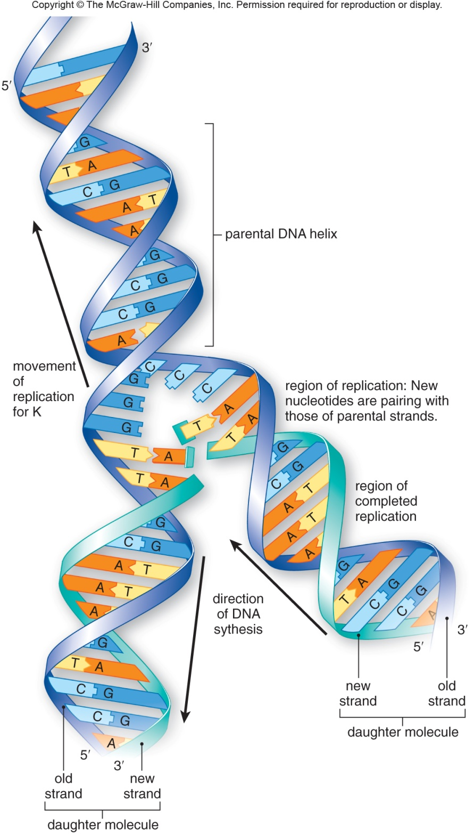
Fig. 11.6

Slide 39
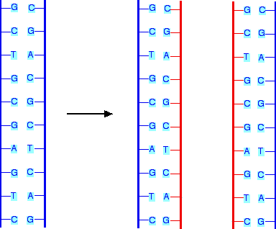
Try this with any sequence of DNA!

Slide 40
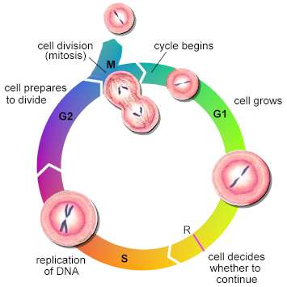
Connecting concepts…
In your cells, where is the DNA?
When is DNA copied?
Why is DNA copied?

Slide 41
We’ve addressed some questions…
If DNA is the the genetic material----how does it work? What does it look like? Is it durable? How is it copied? How does it code for information? How might it change gradually?

Slide 42
More work on DNA…
How does it code for information? What kind of information does it code for?
These are the topics of gene expression (extracting the information stored in DNA)

Slide 43
Gene expression—part 1
Gene expression is really a 2-part process.
1. DNA is changed into a similar molecule called RNA in a process called transcription.
3 types of RNA can be transcribed from DNA. They are known as:
mRNA—the message for the protein encoded in the DNA.
tRNA---an adaptor molecule that helps to decode the mRNA.
rRNA—RNA that is a structural component of the ribosome.

Slide 44
The RNA produced is the complementary sequence to one of the DNA strands.
The DNA and the RNA then, have virtually the same sequence, but are made from slightly different chemicals.

Slide 45
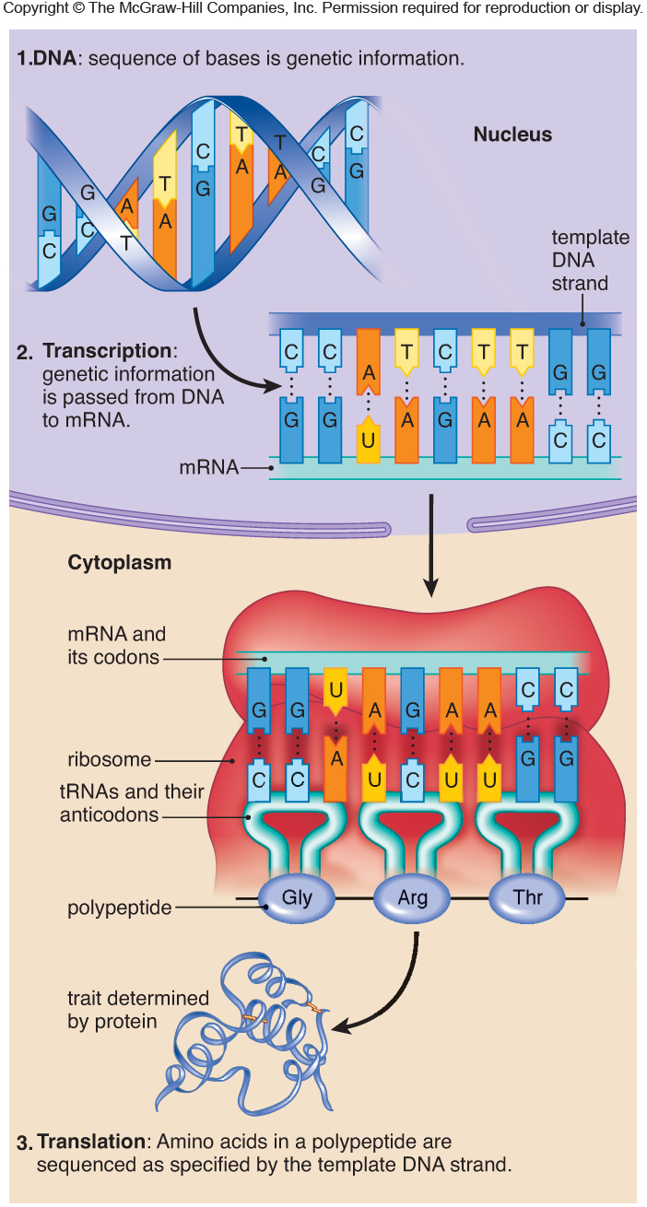
Fig. 11.9

Slide 46
Gene expression—part 2
Gene expression is really a 2-part process.
2. The mRNA produced in transcription is translated into a protein.
Translation requires the other types of RNA (tRNA and rRNA, and takes place within the ribosomes)
Work in the 1950s-1980s clarified how translation works.

Slide 47
First, lets review what proteins are made of…
Amino acids! There are 20 naturally occurring amino acids---but amino acids are nothing like RNA. How can a sequence of RNA code for a sequence of amino acids?

Slide 48
Cells use a system of 3-nucleotides for each amino acid.
This is called the genetic code. It is referred to as a triplet code.
Each 30 nucleotide code is called a codon.

Slide 49
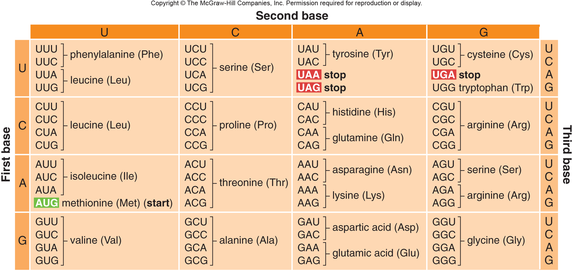
The universal genetic code

Slide 50
Try to decode this mRNA
AUGUCGCUUCAAGAAGCAGCAACAUAA

